Slide 1
Triple “J” Produce, Inc.

Slide 2
Family Owned & Operated
by The Hocutt Family

Slide 3
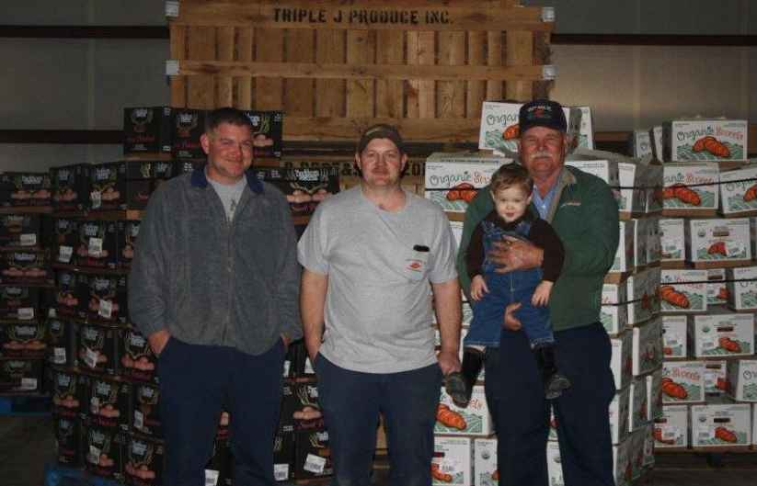
The Hocutts Jay, Joey, Mike, & Joshua

Slide 4
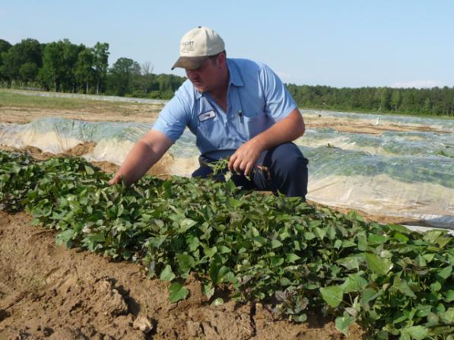
Sweet Potatoes
From Farm….

Slide 5
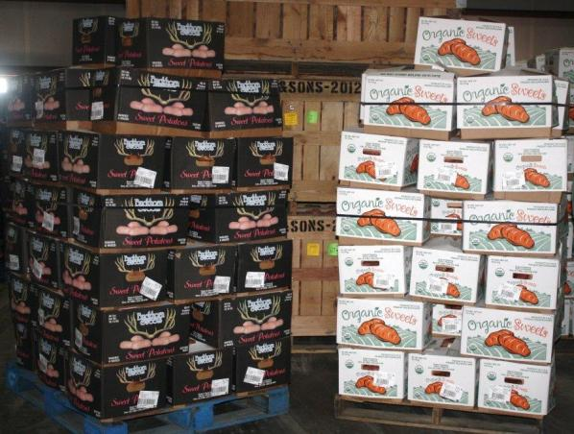
Sweet Potatoes
to Packing

Slide 6
143 Organic Sweet Potato Acres
400 organic acres by 2016

Slide 7
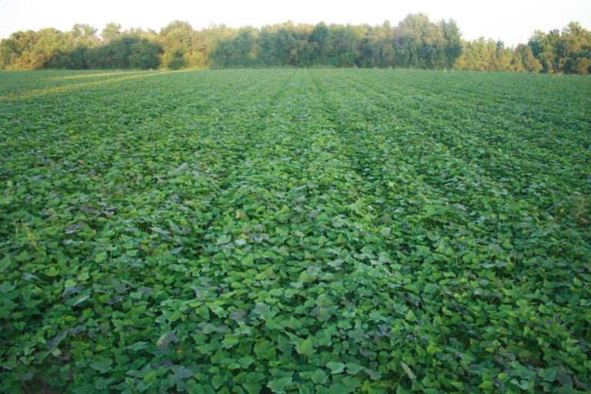
Non Organic Sweet Potatoes
1000 acres

Slide 8
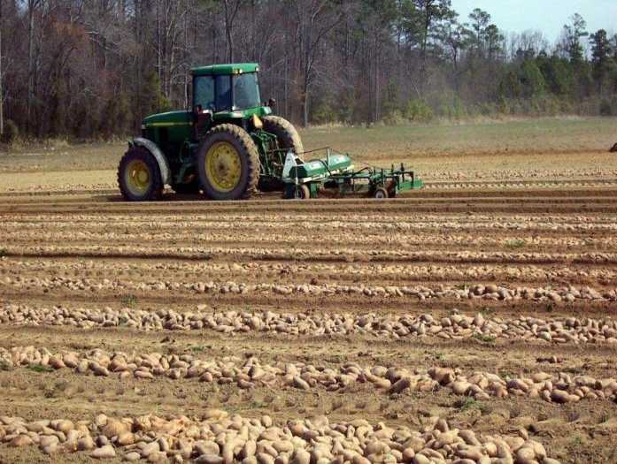
Our Farm is certified by Primus GFS

Slide 10
Our Harvest Crew is certified by Primus GFS as well

Slide 11
Organic Crops We Provide
Sweet Potatoes
Asparagus
Yukon potatoes
Red potatoes
Butternut, Acorn, and Spaghetti Squash

Slide 12
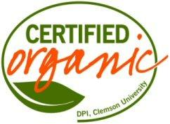
Organic Certifiers

Slide 13
Sweet Potato Varieties

Slide 14
Covington organic & non organic

Slide 15
Muraski organic

Slide 16
Garnet organic

Slide 17
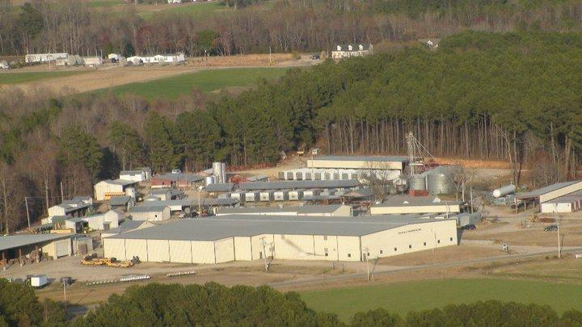
Packing house

Slide 18
Packing house

Slide 19
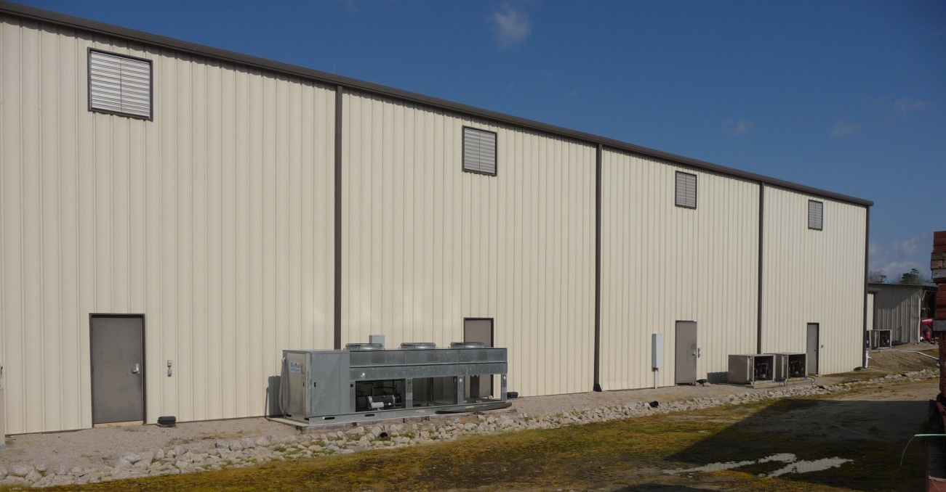
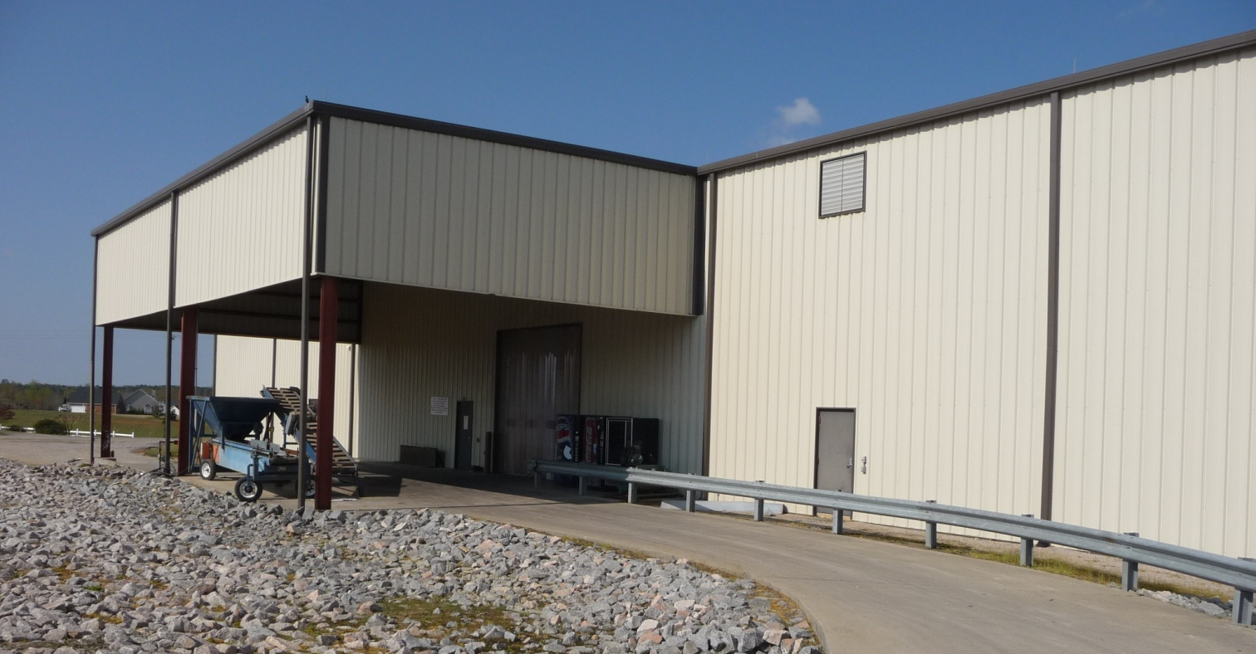
150,000 square feet
Another 100,000 square foot warehouse in Wilson, NC

Slide 20
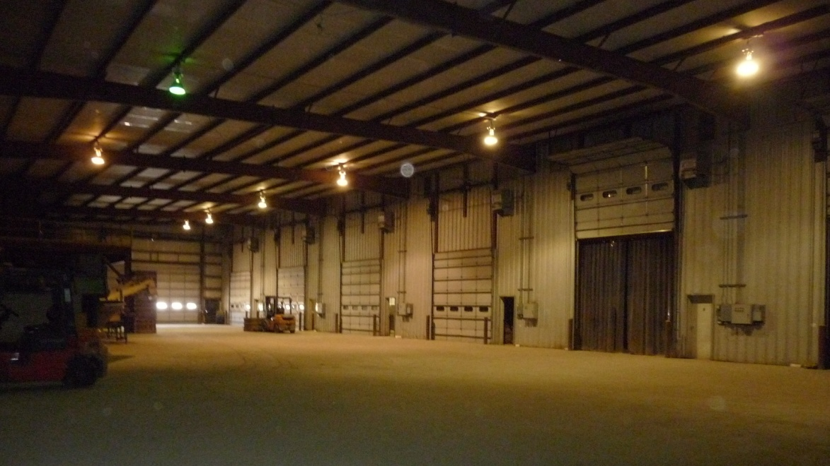
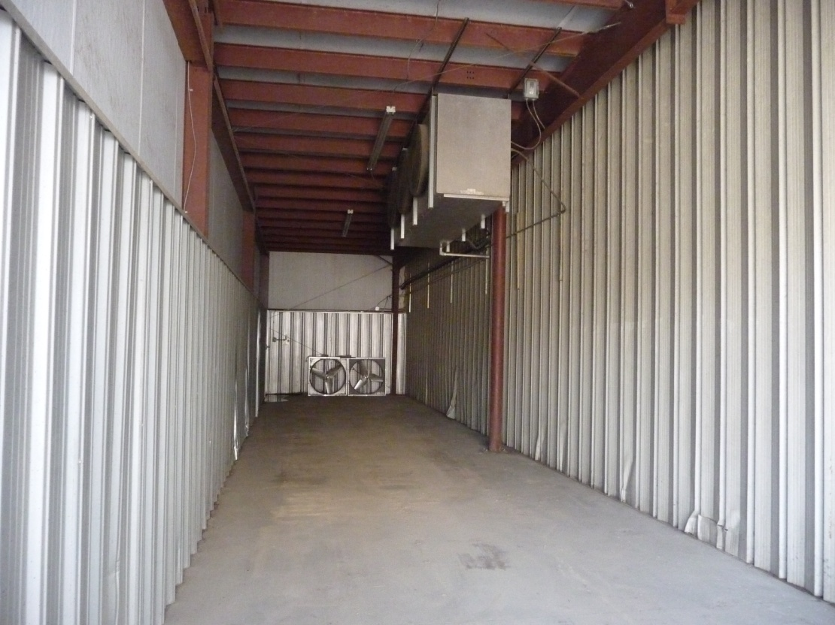
12 Cold Storage Rooms

Slide 21
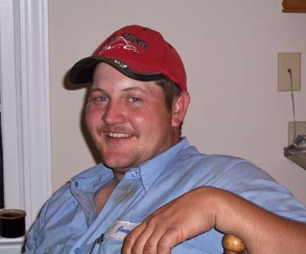
Joey Hocutt, Vice President
Packing House Supervisor

Slide 22
Packing House Certifiers

Slide 23
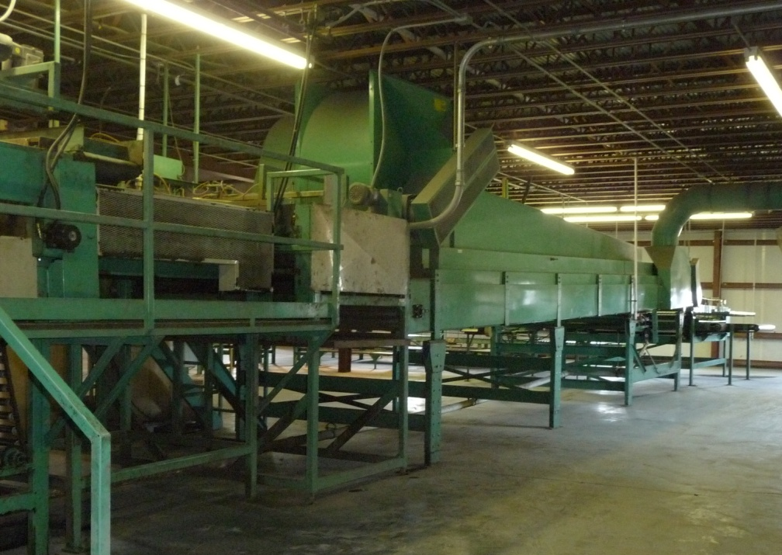
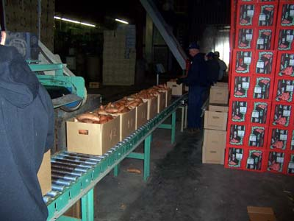
Sweet Potatoes packed year round

Slide 24
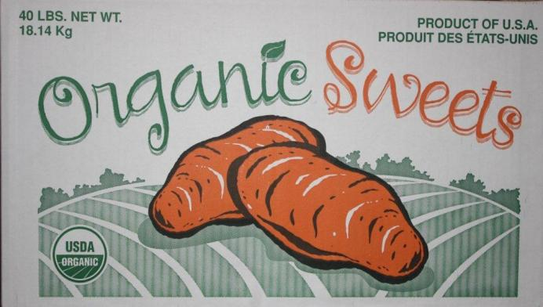
Organic Packaging
40 lb cases

Slide 25
Organic Packaging

Slide 26
Organic Packaging
Microwavable

Slide 27
Non Organic Packaging
40 lb cartons

Slide 28
Non Organic Packaging
Microwavable

Slide 29
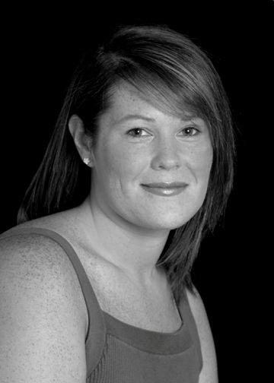
Kristi Hocutt, Sales
kristi@triplejproduce.com 252-289-8326 Phone
252-235-2947 Fax www.triplejproduce.com

